Slide 1
AWS Cloud​Formation AWS Cloud Formation provides a common language for you to describe and provision all the infrastructure resources in your cloud environment. Cloud Formation allows you to use a simple text file to model and provision, in an automated and secure manner, all the resources needed for your applications across all regions and accounts. This file serves as the single source of truth for your cloud environment. AWS Cloud Formation is available at no additional charge, and you pay only for the AWS resources needed to run your applications.

Slide 2
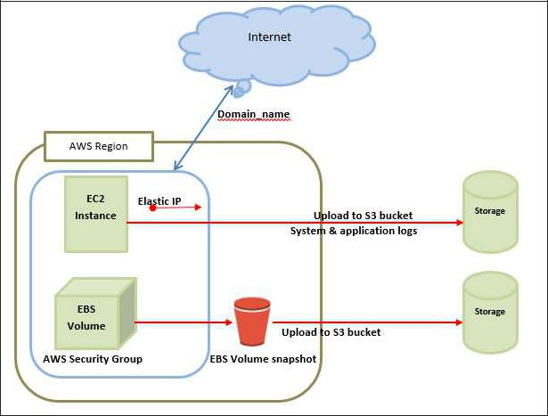
AWS ─ Basic Architecture

Slide 3
EC2 components

